Slide 1
Introductory course of Su Jok therapy

Slide 2
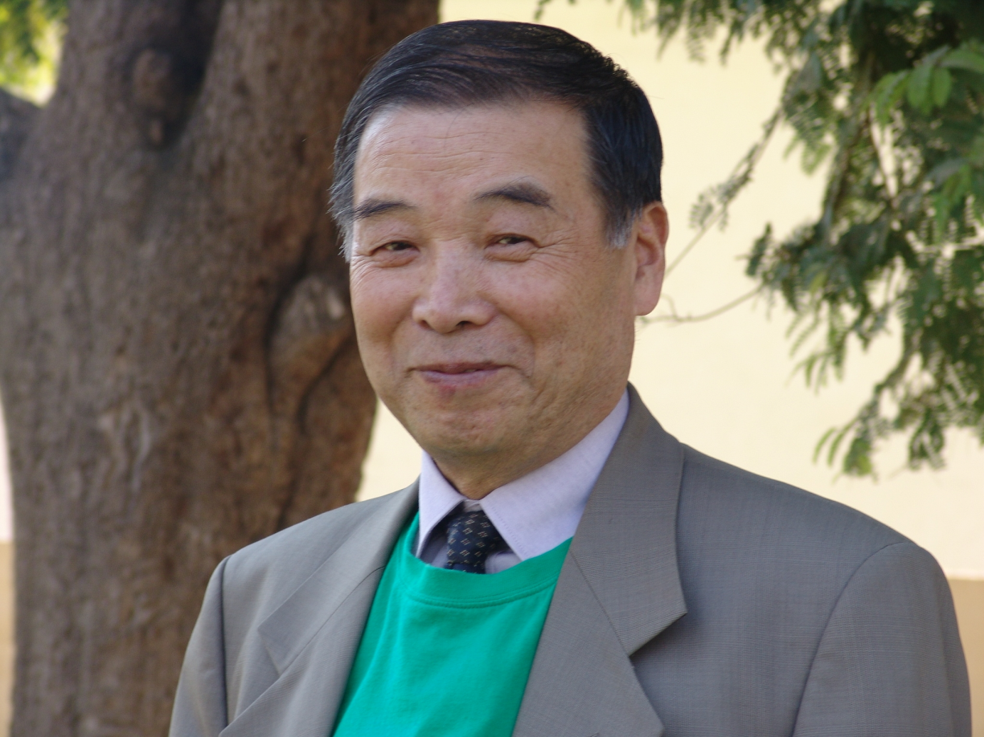
Prof. Park Jae Woo
Prof. Park Jae Woo is Korean philosopher and guide who invented Su Jok for the benefits of mankind. Prof. Park Jae Woo was born on 11th March 1942 in Korea. He left his physical body on 25th March 2010 in Moscow. Prof. Park Jae Woo was very intelligent, modest and scientific minded personality. When He started understanding fundamentals of existence, He discovered the truth in no time and created wonderful science named Su Jok and Triorigin.

Slide 3
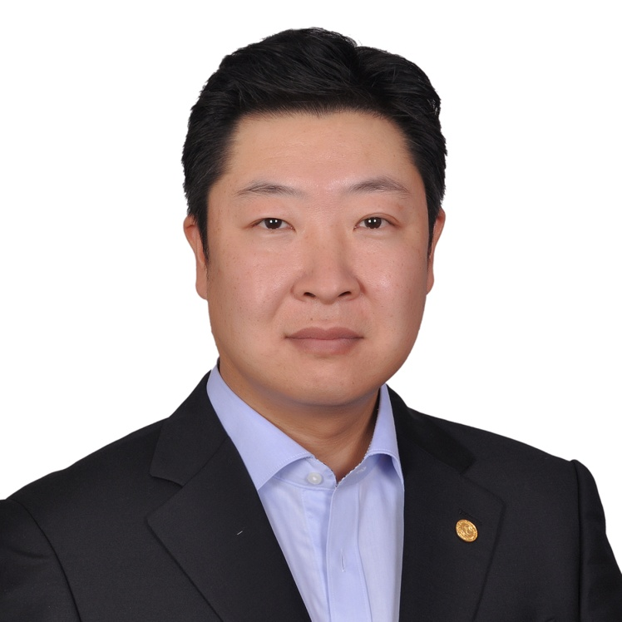
About ISA
International SuJok Association (ISA) is group of devoted and dedicated disciples of Prof. Park Jae Woo who are determined to create pain free society and creating smile civilization as dreamt by our beloved Prof. Park Jae Woo.
This organization was found by Prof. Park Jae Woo and now is being headed by Global President Dr. Park Minchul (Elder son of Prof.) and Global Vice President Dr. Park Minkyu (Younger son of Prof.)
Dr. Park Minchul
Global President , ISA.

Slide 4
Aim of ISA
To spread all the theories and methods of treatment developed by
Prof. Park, Jae Woo.
Homo system of body correspondence
Six Ki theory
Eight Origins theory
Triorigin theory
Diamond energy system
Spiral energy system
Triorigin correspondence system
Sujok Ki therapy
Sam Won Dong
Twist Therapy
Smile meditation
Smile Yoga
Direction therapy
Smile breathing
Triorigin Smile mudra
Triorigin Smile mantra
Triorigin Feng Shui
Triorigin Acupuncture
Seed therapy
Nail therapy
and other…

Slide 5
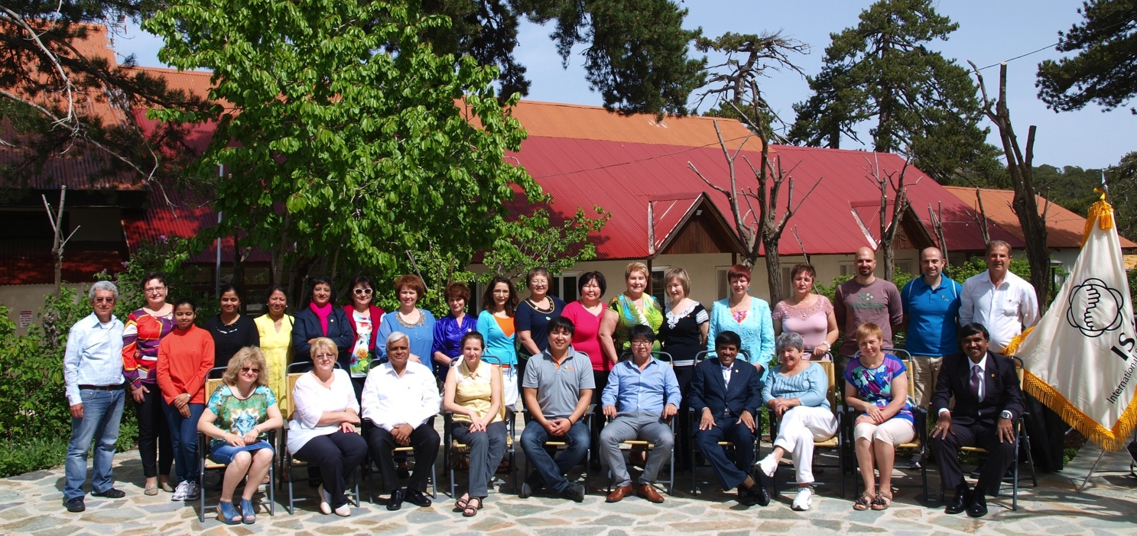
In May-2013 we had Global congress in Cyprus in which from 13 countries -more than 30 participants had participated.
We decided to work on Research & development program for claim of Noble prize for Triorigin Theory.

Slide 6
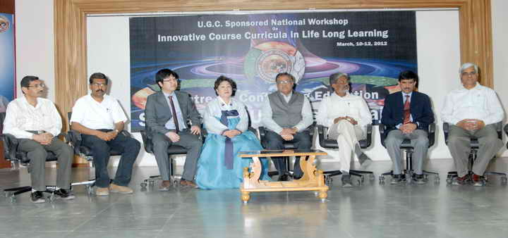
International Sujok Association (ISA) has been doing various activities for quite some time. Some important activities that happened in recent times in India:
Saurashtra University has recognized theories of Prof. Park Jae Woo and honored him on 11th March 2012 by establishing Prof. Park Chair and Gallery in University campus at Rajkot in Gujarat.
Diploma in Su Jok therapy course Saurashtra University had started in year 2008.

Slide 7
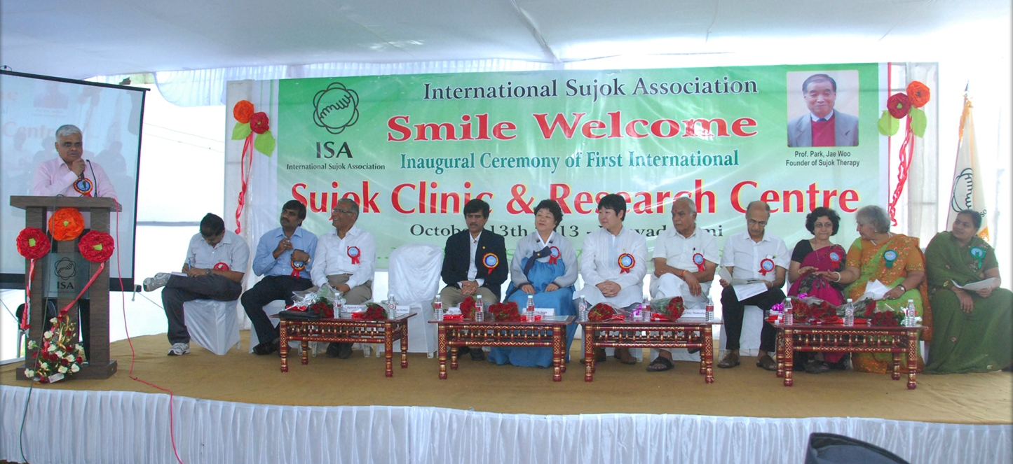
We started our 1st Global level Sujok Clinic & Research center in India at Nagpur on 13th October 2013 (Vijaya Dashmi).

Slide 8
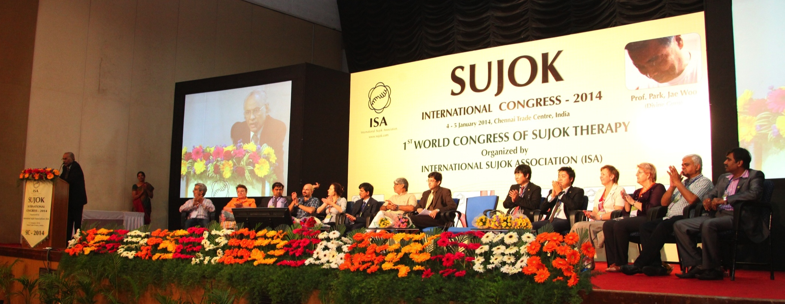
On 4th & 5th January 2014 we had Su Jok international congress in Chennai in which in inaugural function Governor of Tamilnadu K. Rossaiah ji had come as chief guest and Guest of honor Vice Chancellor of Saurashtra University.
In closing ceremony Principle Secretary for Health (Tamilnadu) as Chief Guest, High court Judge had been Guest of honor and along with Special Guest Dr. Kaladhar Arya Director of Continue Education of Saurashtra University.

Slide 9
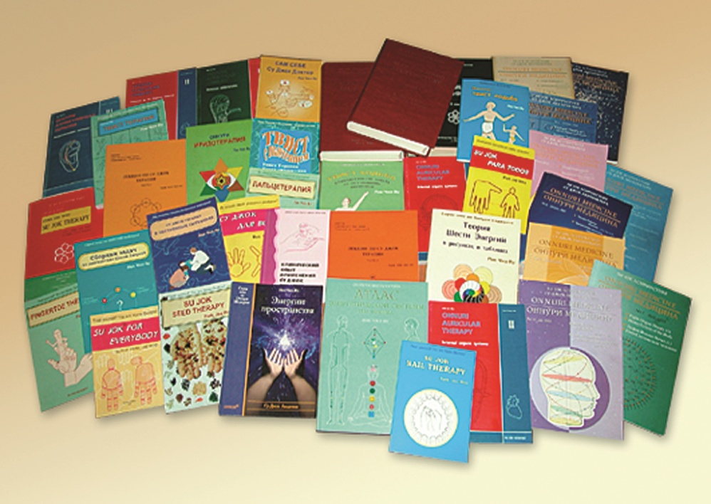

Slide 10
SUJOK
Correspondence
System
Presentation created by
ISA Education team

Slide 11
Similarity between body and hands/feet

Slide 12
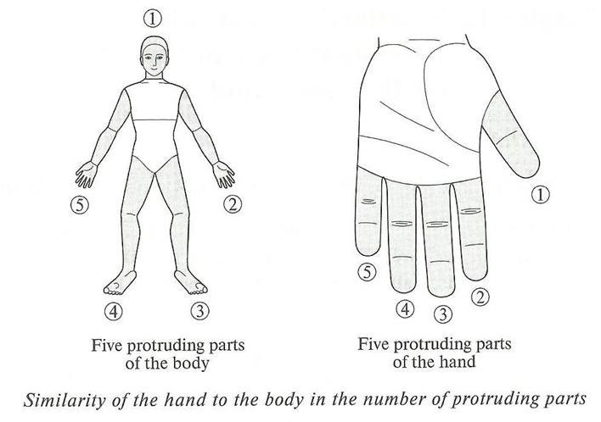
Similarity in number of protruding parts

Slide 13
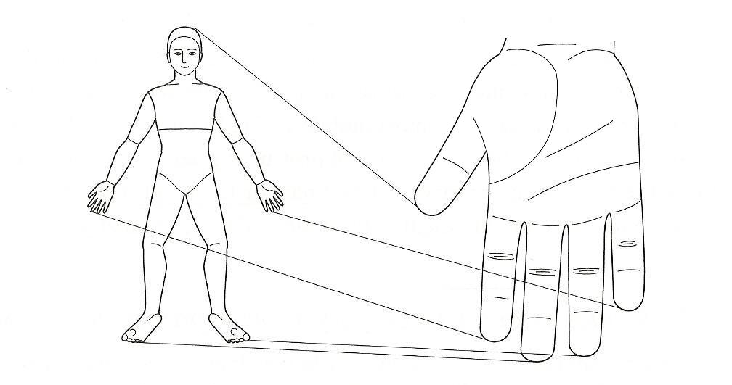
Similarity in location levels of protruding parts

Slide 14
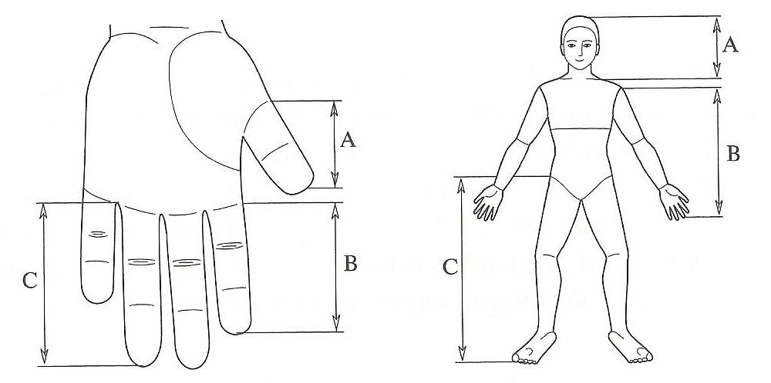
Similarity in proportions of protruding parts

Slide 15
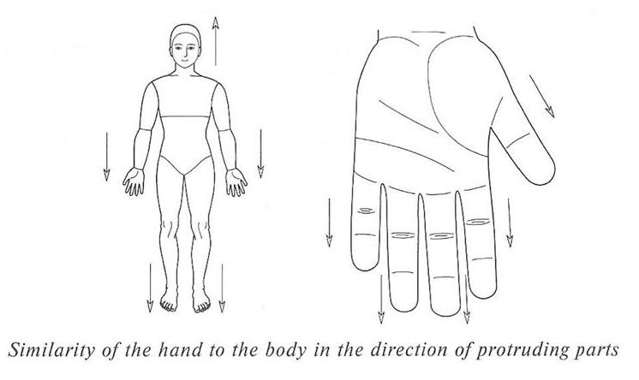
Similarity in direction of protruding parts

Slide 16
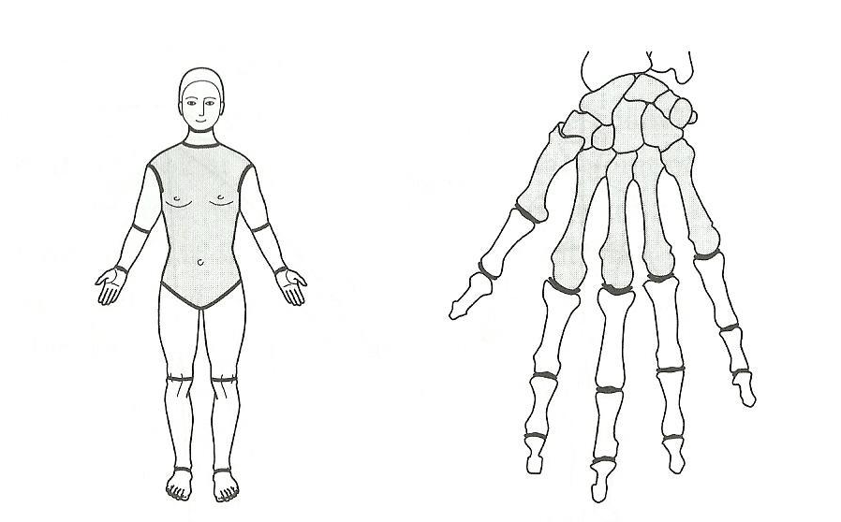
Similarity in number of segments
and joints of protruding parts

Slide 17
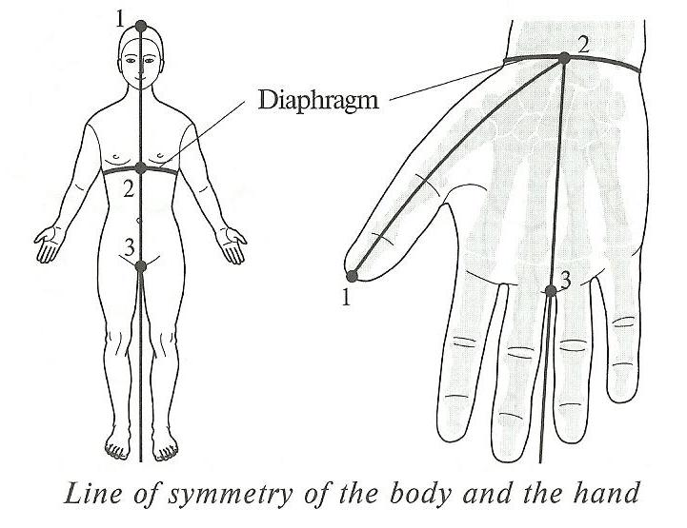
Line of symmetry of body and hand

Slide 18
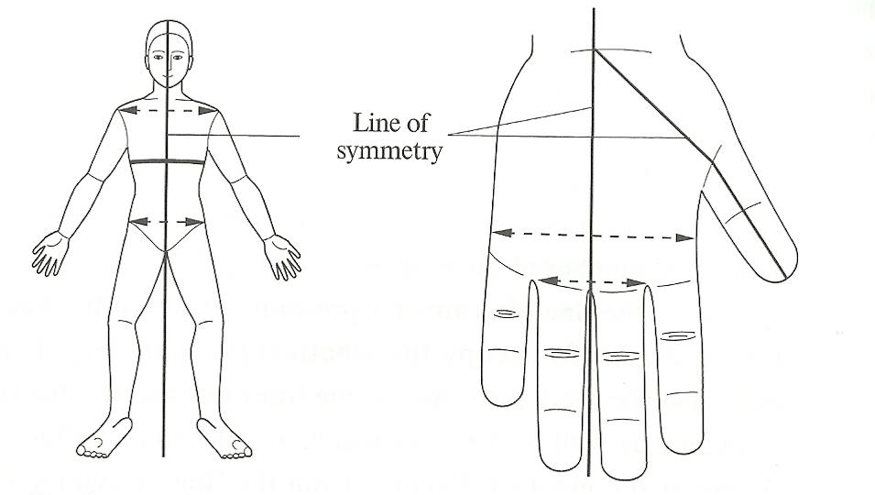
Similarity in relation of protruding
parts to the line of symmetry

Slide 19
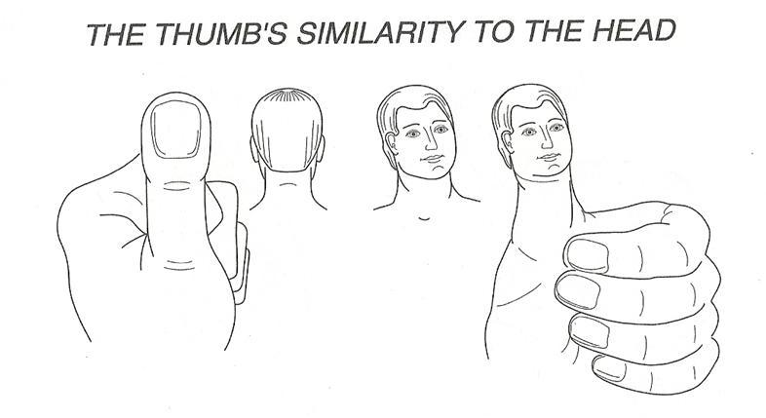
Thumb is Head (similar shape)

Slide 20
Function of head in body and
function of thumb in hand.
Additional evidences of similarity.

Slide 21
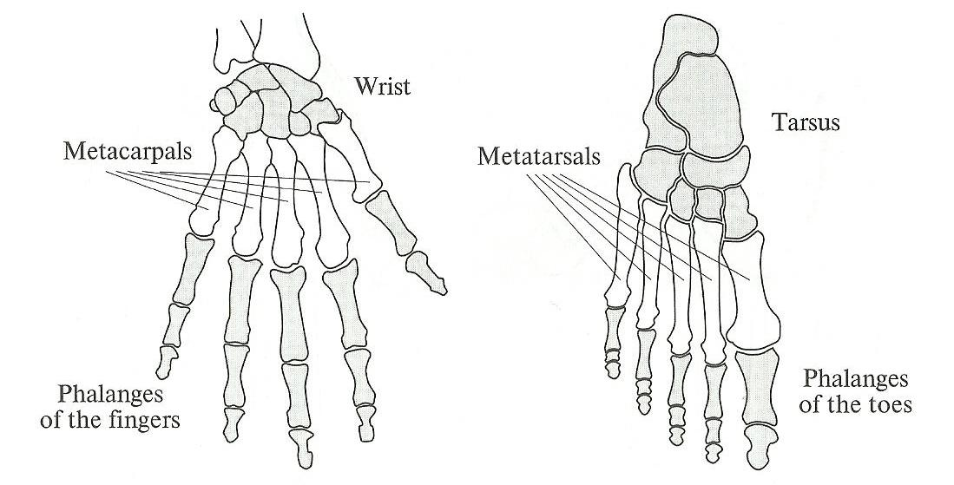
Similarity in the bone structures
of the hands and feet

Slide 22
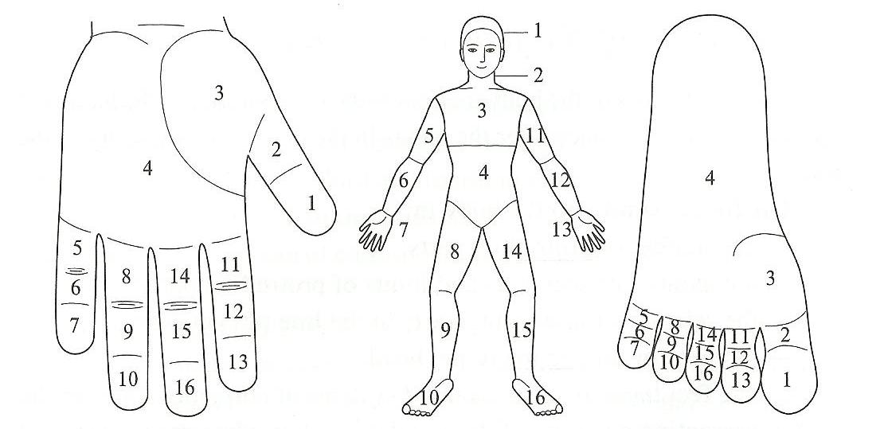
Location of correspondences
of various parts on hands and feet

Slide 23
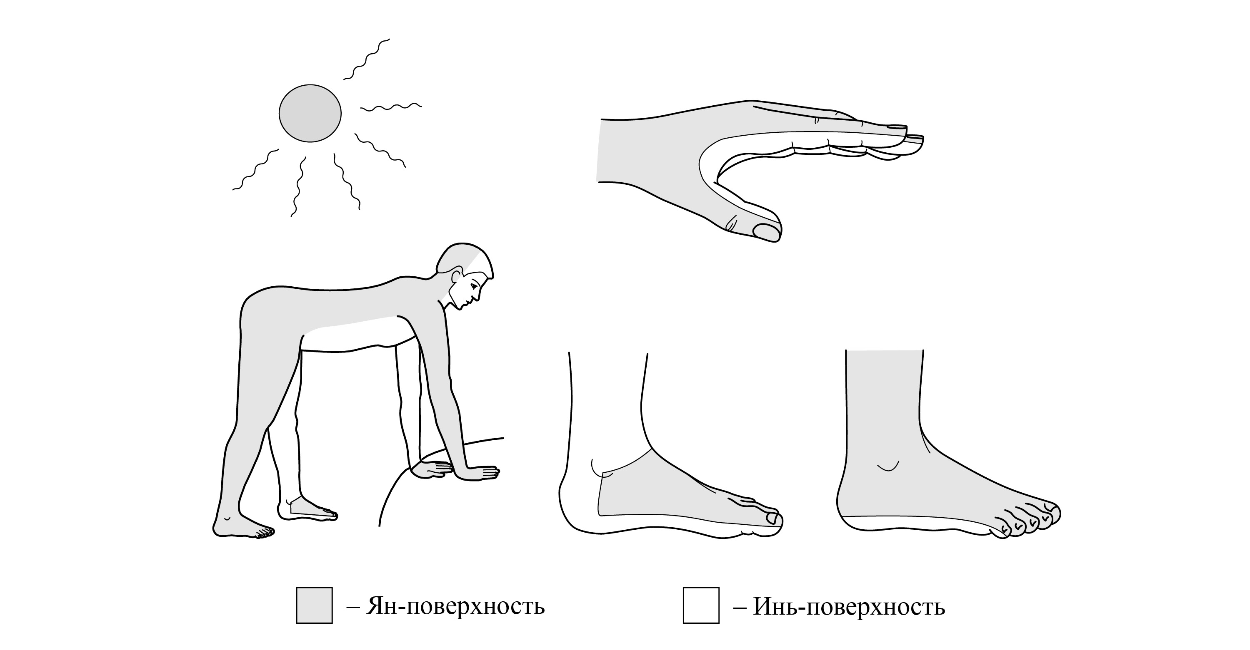
Yin – Yang border of body, hands & feet

Slide 24
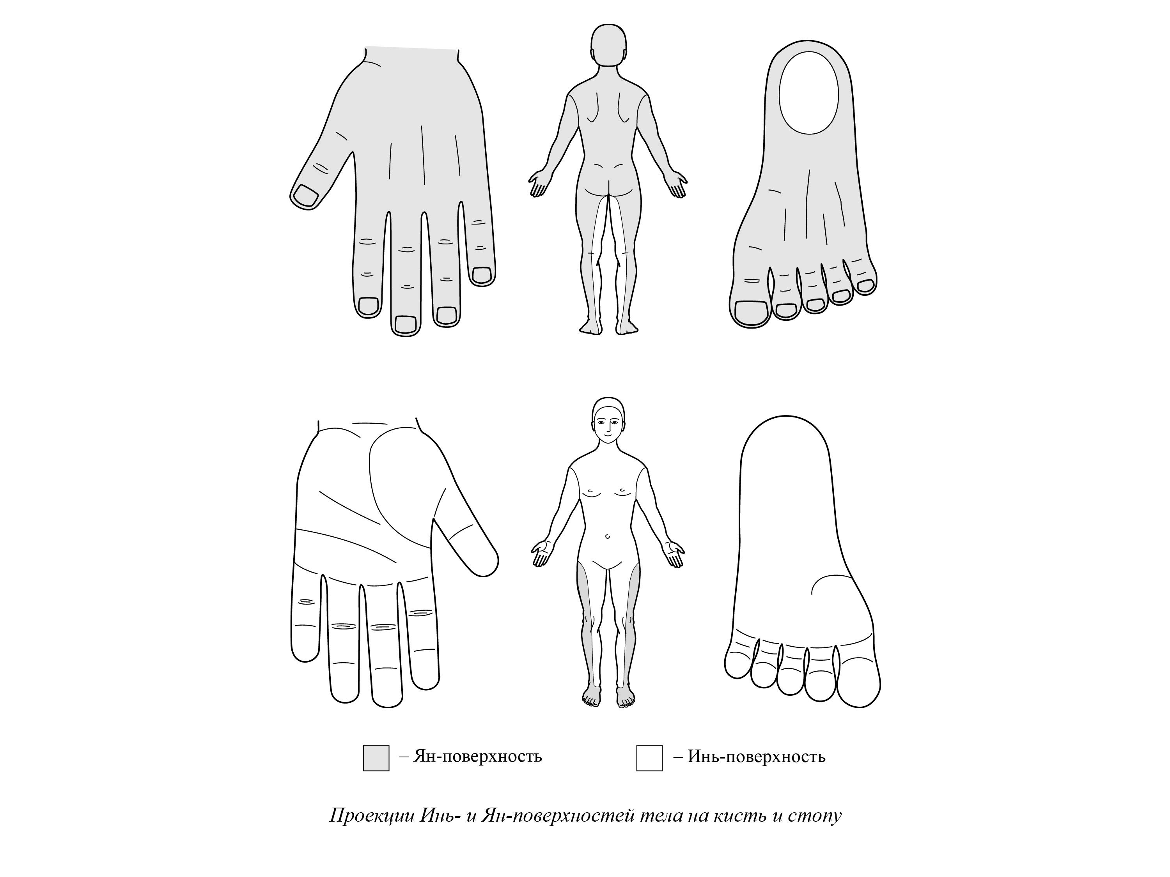
Yin – Yang border of body, hands & feet

Slide 25
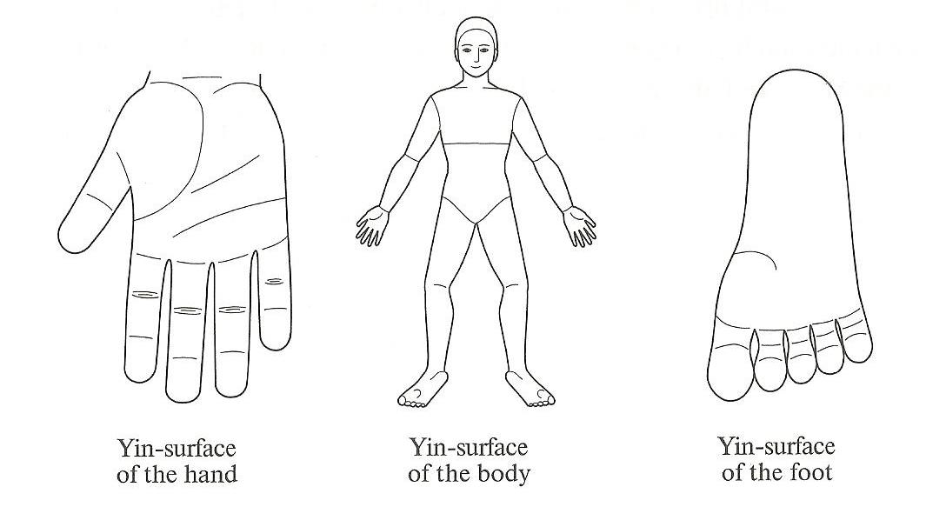
Recommended position to compare
body with hands & feet

Slide 26
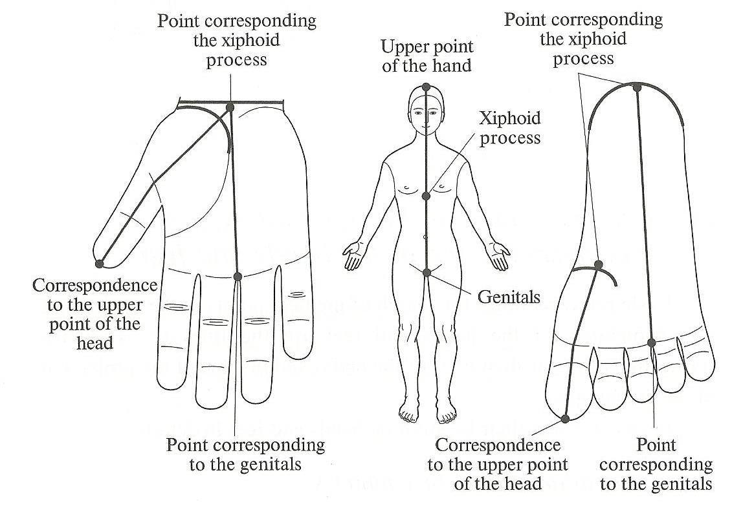
Projections of median line of body
on the Yin surface of hands & feet

Slide 27
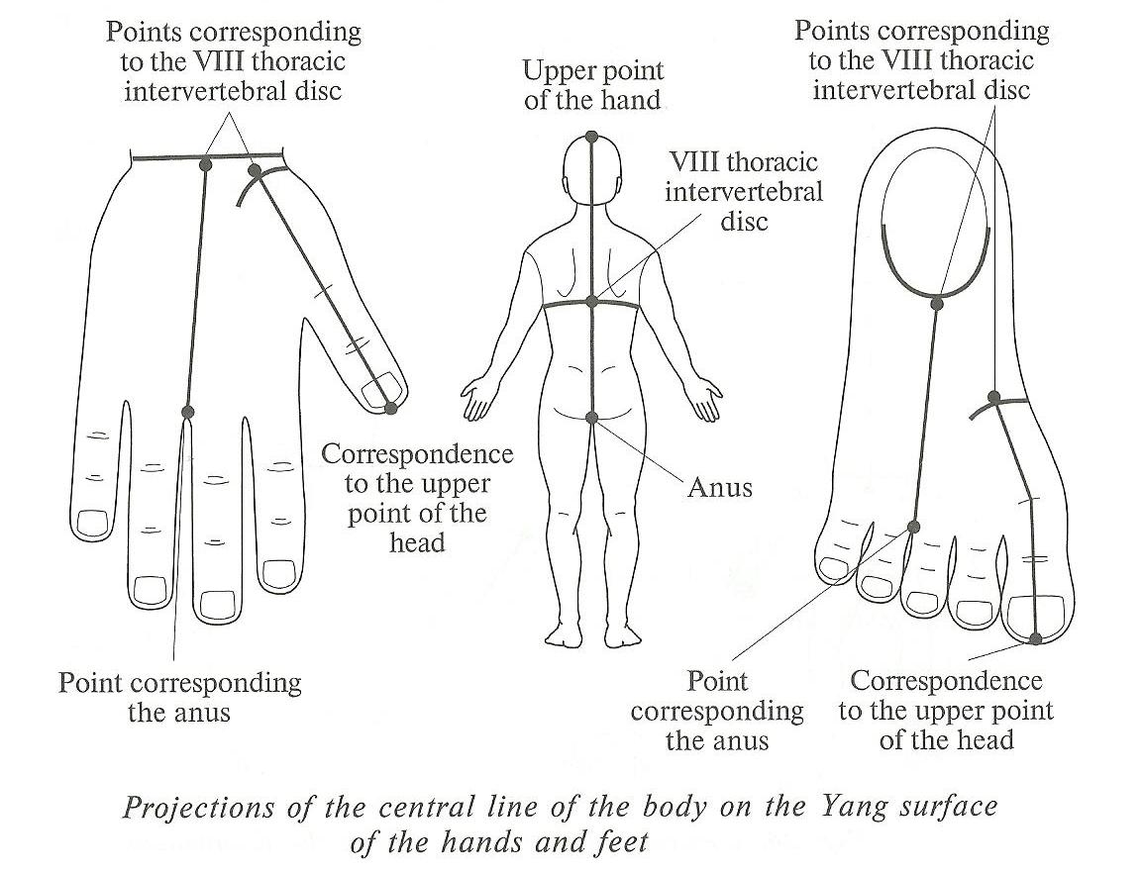
Projections of the central line of body
on the Yang surface of hands & feet

Slide 28
First standard position of hand to find points of areas above diaphragm
Second standard position of hand to find points of areas below diaphragm

Slide 29
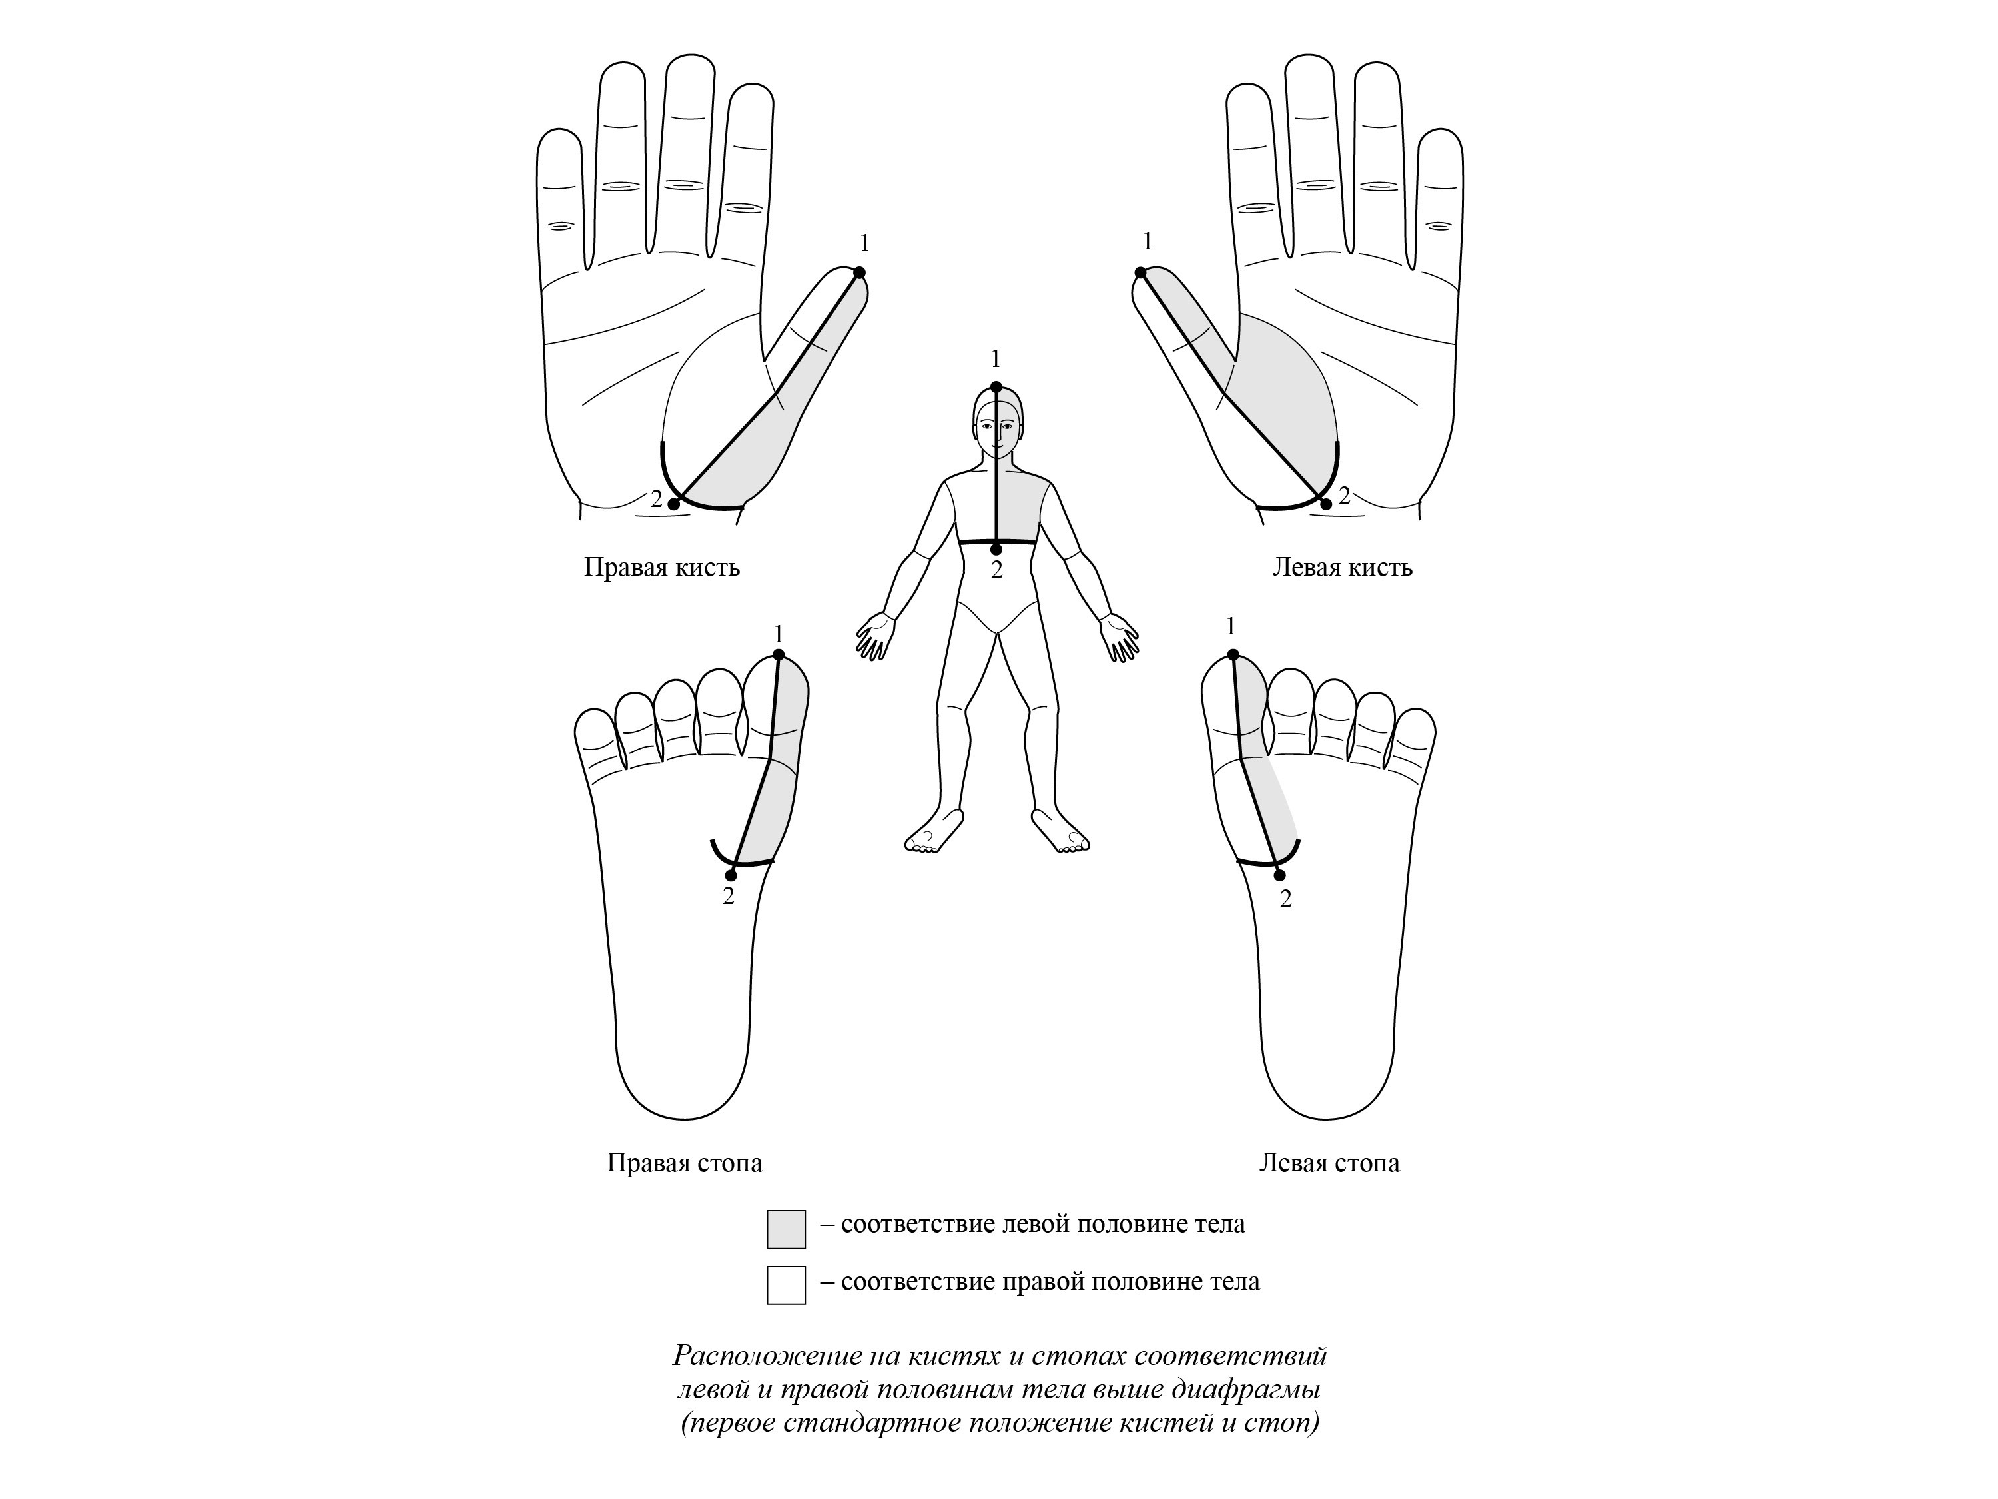
Left half of body
Left half of body
Left half of body above diaphragm
(first standard position of hands and feet)

Slide 30
Left half of body
Left half of body
Left half of body below diaphragm
(second standard position of hands and feet)

Slide 31
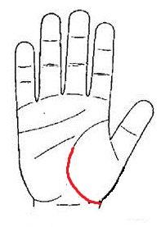
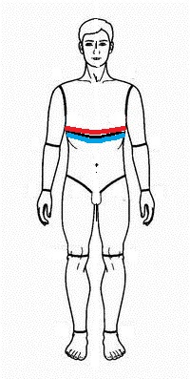
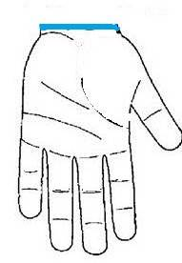
Projections of diaphragm on Yin - surface
“Upper” line of
diaphragm
“Lower” line of diaphragm

Slide 32
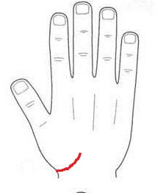
Projections of
diaphragm on Yang - surface

Slide 33
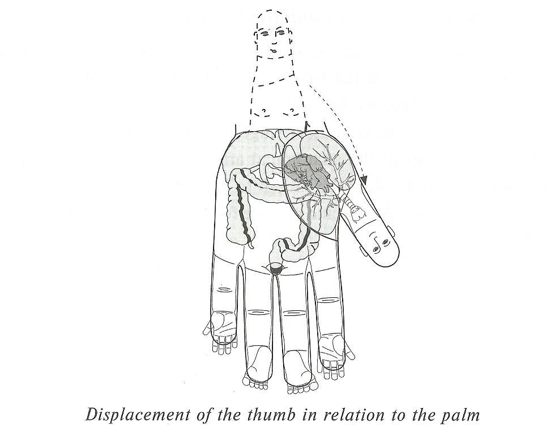
Displacement of thumb
in relation to the palm

Slide 34
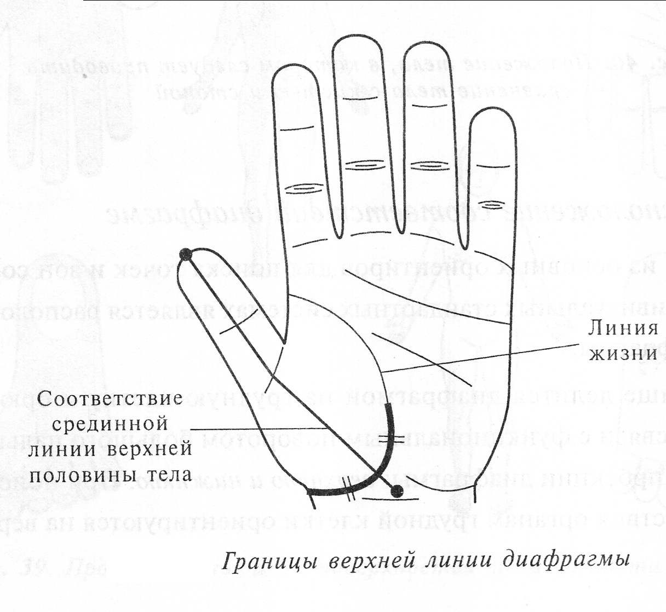
“Life” line
Central line above diaphragm
“Upper” line of diaphragm and central line

Slide 35
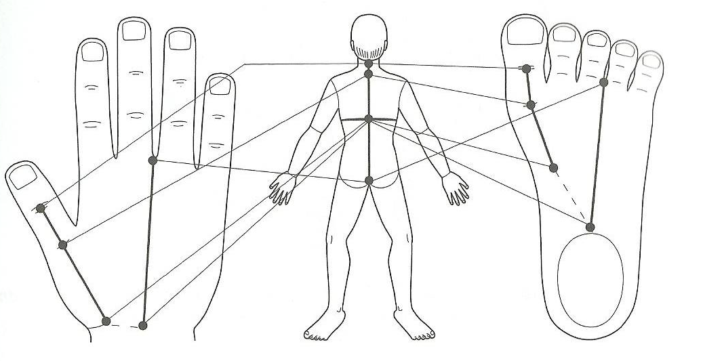
Projection of the backbone on to the hand and foot

Slide 36
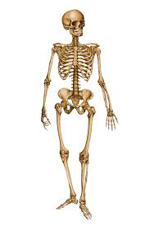

Slide 37
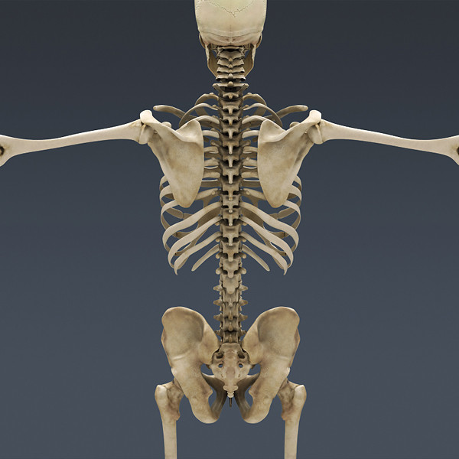

Slide 38
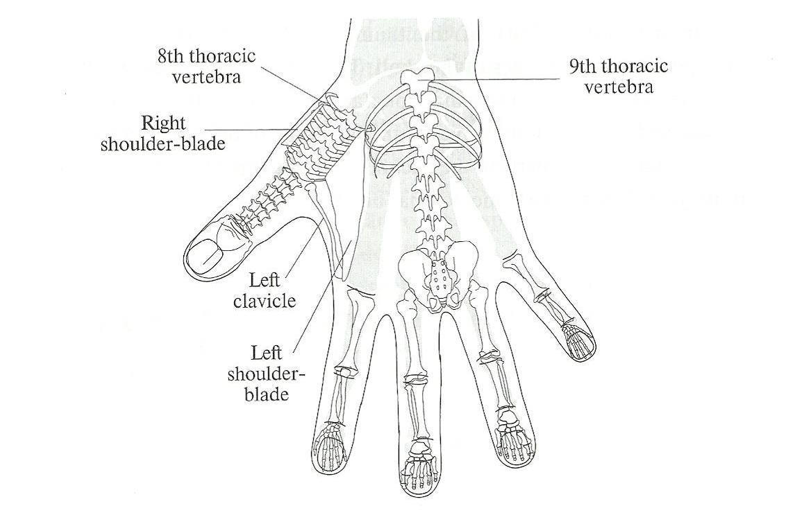
Projection of skeleton
in Standard correspondence system

Slide 39
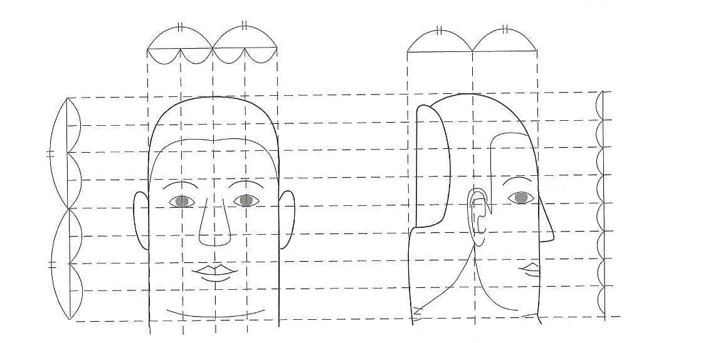
Correspondence to the head
on the distal phalanx of thumb

Slide 40
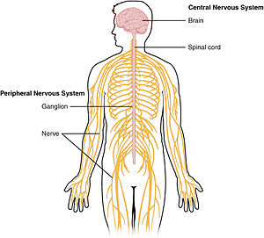

Slide 41
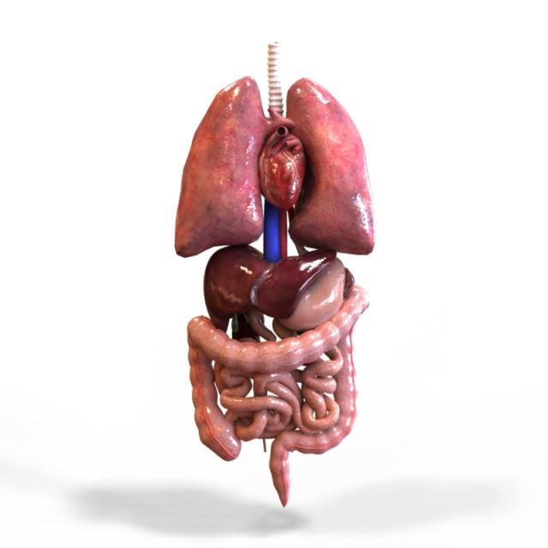

Slide 42
Digestive System

Slide 43
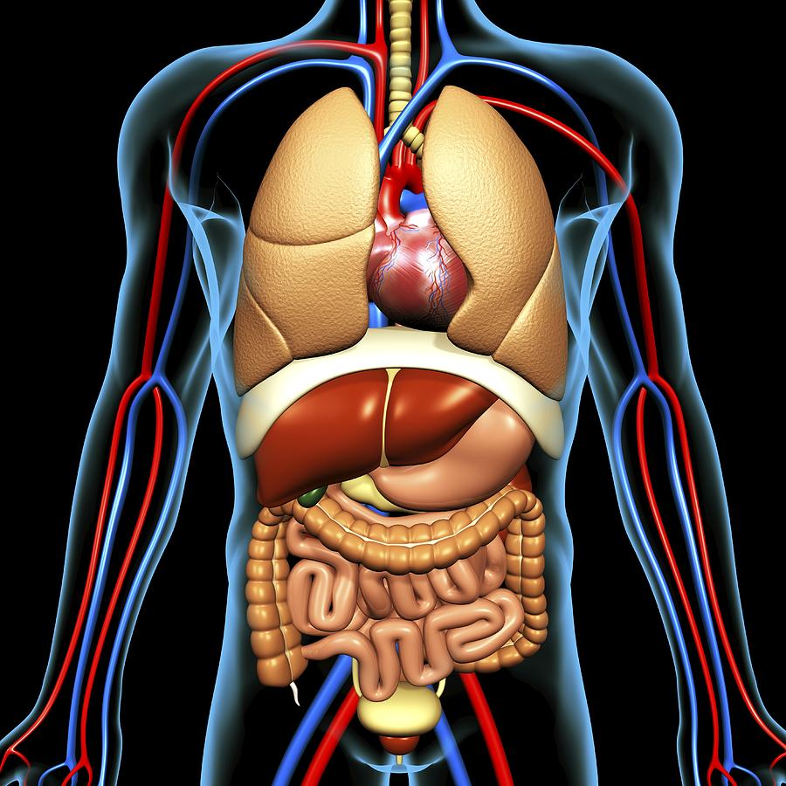

Slide 44
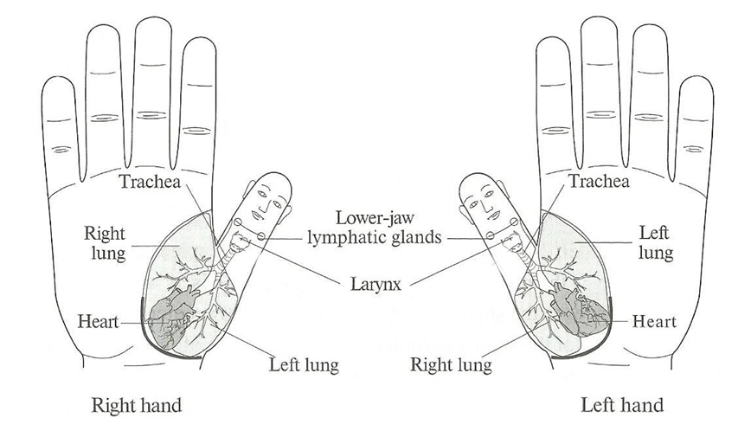
Correspondences to organs
of neck and thoracic cavity

Slide 45
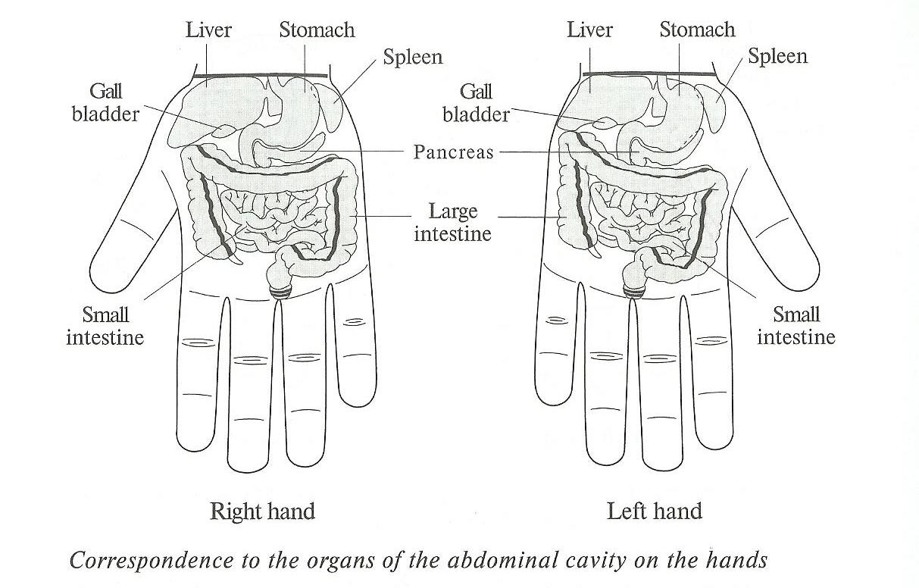

Slide 46
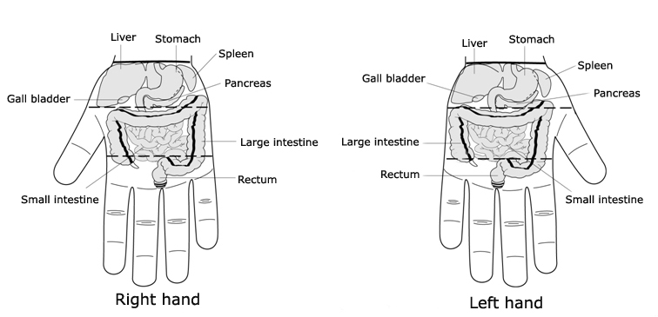
Correspondences to organs
of the abdominal cavity

Slide 47
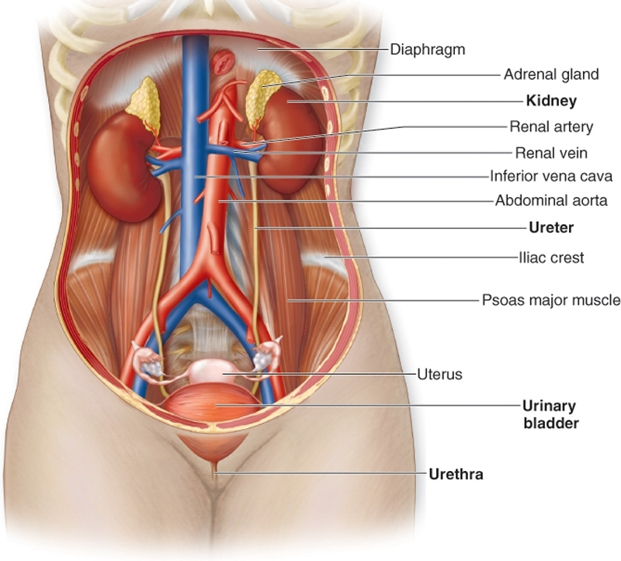
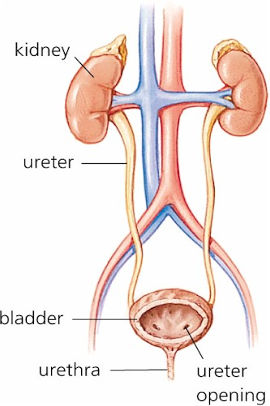
Excretory system

Slide 48
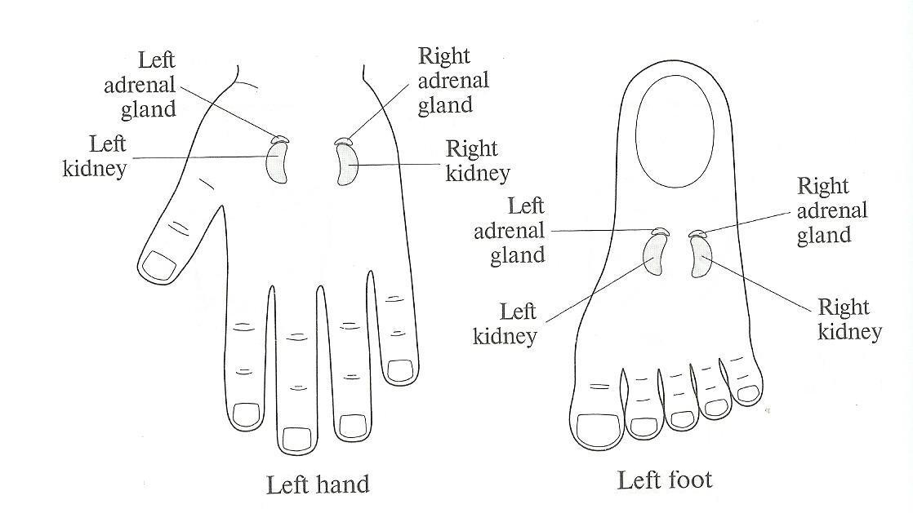
Correspondences to kidneys and
adrenal glands on the Yang-surface

Slide 49
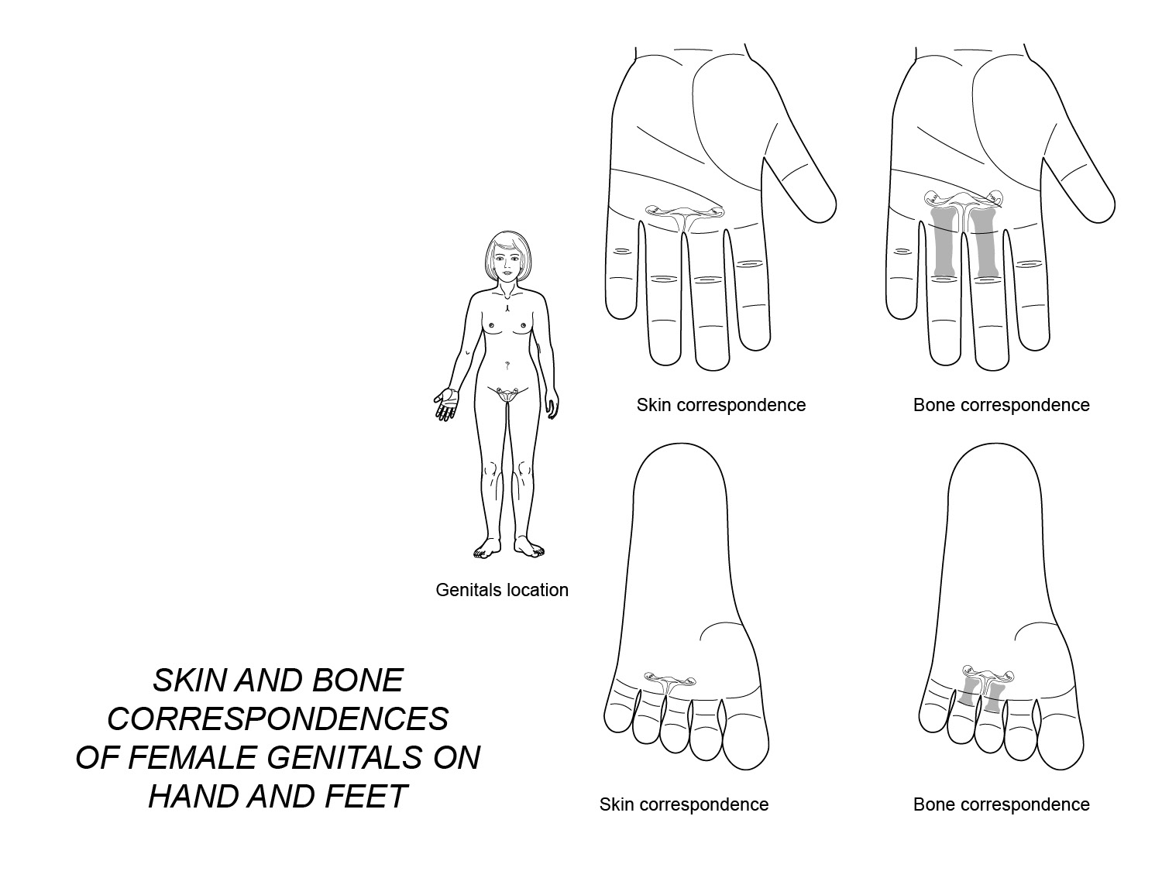

Slide 50
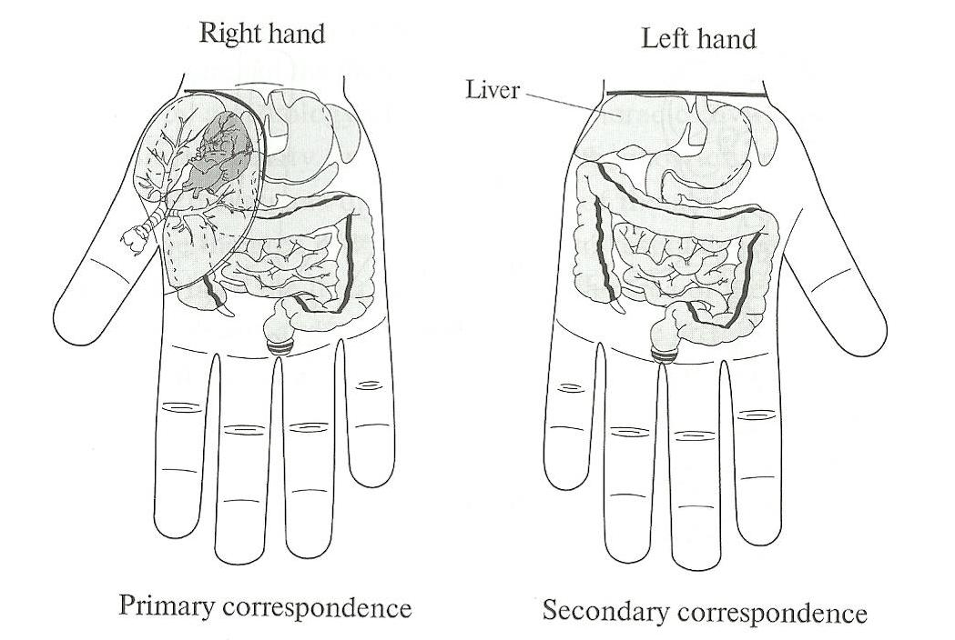
Using left hand for diagnosis of
diseases of organs on right side

Slide 51
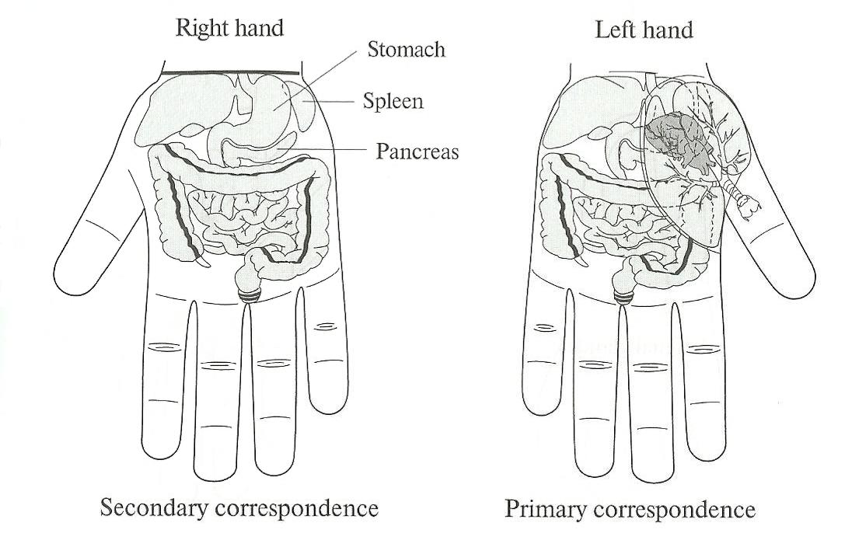
Using right hand for diagnosis of
diseases of organs on left side

Slide 52
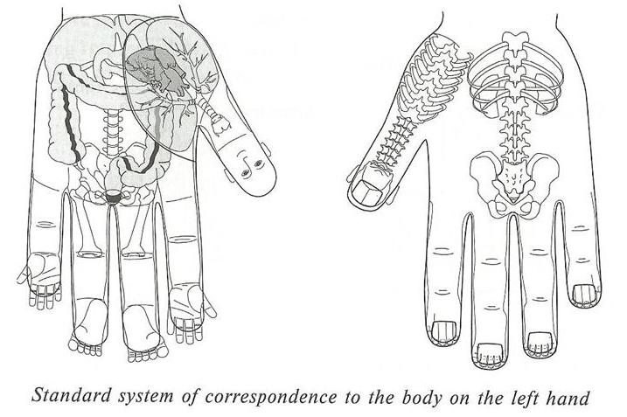
Standard system of correspondence
to the body on the left hand

Slide 53
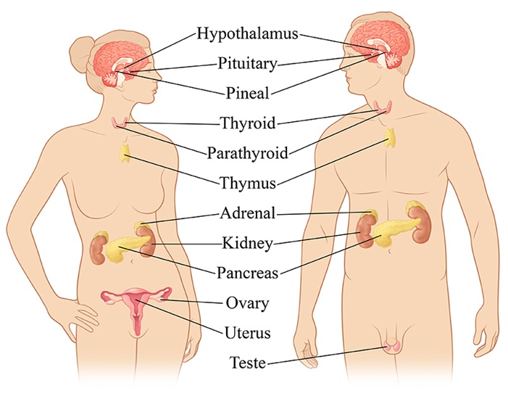
Endocrine system

Slide 54
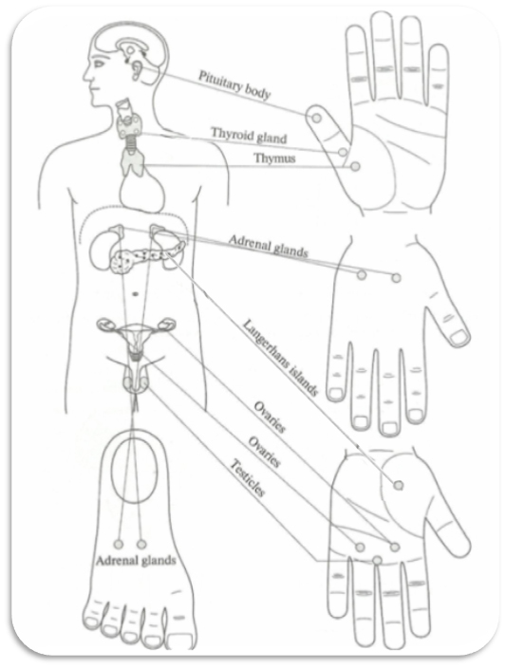
Projections of
endocrine glands

Slide 55
First Step: Determine in which of the seven regions (head, four extremities, thoracic or abdominal cavity) the problem is located.
Second Step: Assume relevant position of hand or feet
based on whether the problem is above or below diaphragm.
Third Step: Determine on which surface, Yin or Yang,
the problem is mostly projected on checking all the points in correspondence area.

Slide 56
Fourth Step: Determine in what half of the body – left or right – the problem is located.
Fifth Step: If problem is located on the trunk the area of correspondence is found by using additional imaginary lines: midclavicular, axillary, umbilical etc.
Sixth Step: The right point is identified by sharp pain
on checking all the points in correspondence area.

Slide 57
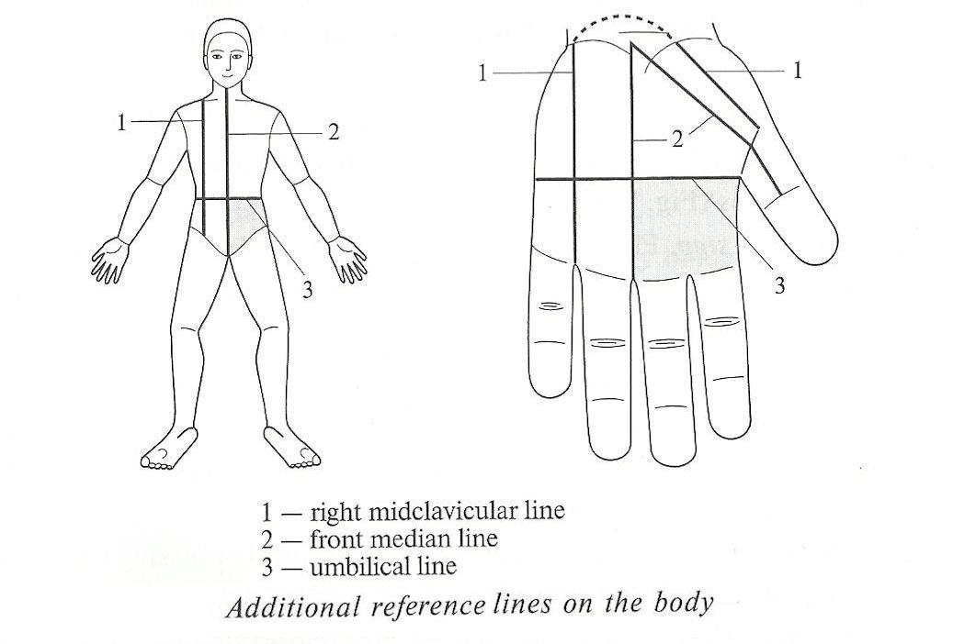
Additional reference lines on the body

Slide 58
Technique of searching correspondence
points on extremities

Slide 59
Massage of the heart correspondence by diagnostic probe

Slide 60
Massage of the heart correspondence area by fingers

Slide 61
Smile Thanks

